Slide 1
Getting starting with command-line bioinformatics: An introductive note for a beginner
@ange_omics
25th November, 2022

Slide 2
Ten rules to get started!
1
Terminology
6
Scripting
2
Tool selection
7
Monitoring
3
Resources needed
8
File handling
4
Platform selection
9
Take note again and again!
5
Software installation
10
No 빨리빨리… Be Patient

Slide 3
1
Terminology

Slide 4
1
Terminology
WALLTIME
CONTAINER
RAM
HPC
THREAD
PIPELINE
EXECUTABLE
CPU
PATH
DEPENDENCY
DEPENDENCY

Slide 5
1
Terminology
STANDARD
HIGH-MEMORY
CPU/CORE
NODE
128 GB
512 GB
RAM

Slide 6
1
Terminology
MULTI-THREADED PROGRAM
OUTPUT
OUTPUT
SINGLE-THREADED PROGRAM
512 GB

Slide 7
2
Tool selection

Slide 8
2
Tool selection
Know your data and assess your need
Data type
Target species
Available computing power
Already tested tools?

Slide 9
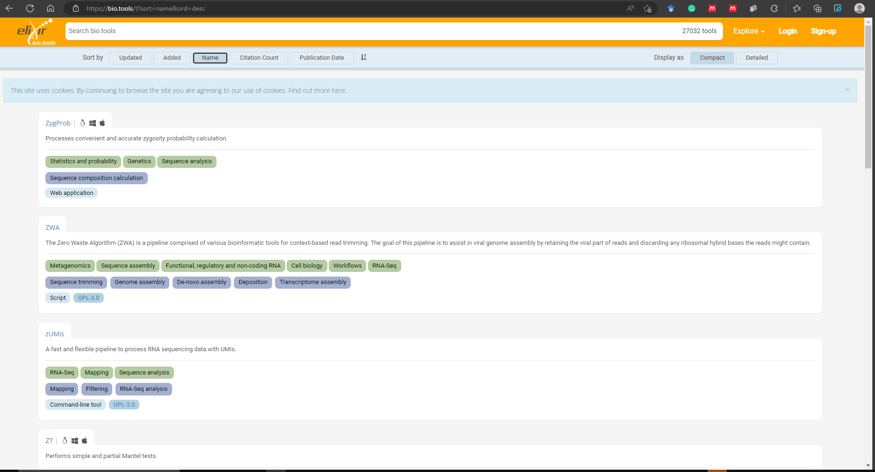
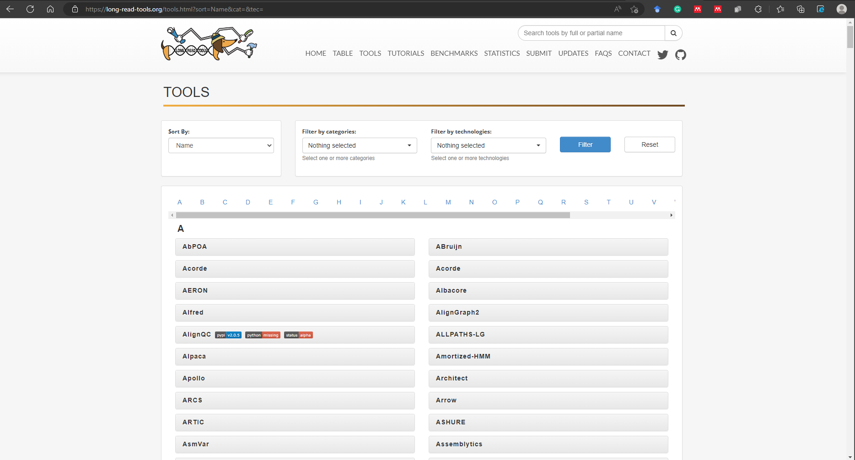
2
Tool selection
Know your data and assess your need – Tools available?

Slide 10
3
Resources needed

Slide 11
3
Resources needed
32 CPUs
128 RAM
1TB Storage
Estimating your computing requirements
Tool documentation + datasets
Tools benchmarking papers
Ask colleagues

Slide 12
4
Platform selection

Slide 13
4
Platform selection
Cloud
Personal Computer/work station
Customised computing resources
Unshared resource (live programming)
Unshared resource (live programming)
Both free and paid commercial options
Fixed computing resources
Resource not shared(live programming)
Compute environment self controlled
Cost for acquisition but flexibility
https://ronin.cloud/
https://aws.amazon.com/
https://cloud.google.com/
Shared HPC
Fixed computing resources
Shared resource (scheduled jobs)
Compute environment largely controlled by IT
Usually freely available based on institution/merit

Slide 14
5
Software installation

Slide 15
5
Software installation
Manual
Package managers
Containers
Download
Unpack
Configure
Build
Install
Docker
Singularity
APT –Debian/Ubuntu
Yum – RedHat/Centos
Conda/Bioconda/Mamba
Workflow managers
Nextflow
Snakemake
Galaxy

Slide 16
6
Scripting

Slide 17
6
Scripting
https://github.com/
Write your script
Check syntax and minor scripting error
Software well installed
Dependencies well installed
Resource sufficient?
https://snyk.io/code-checker/

Slide 18
7
Monitoring

Slide 19
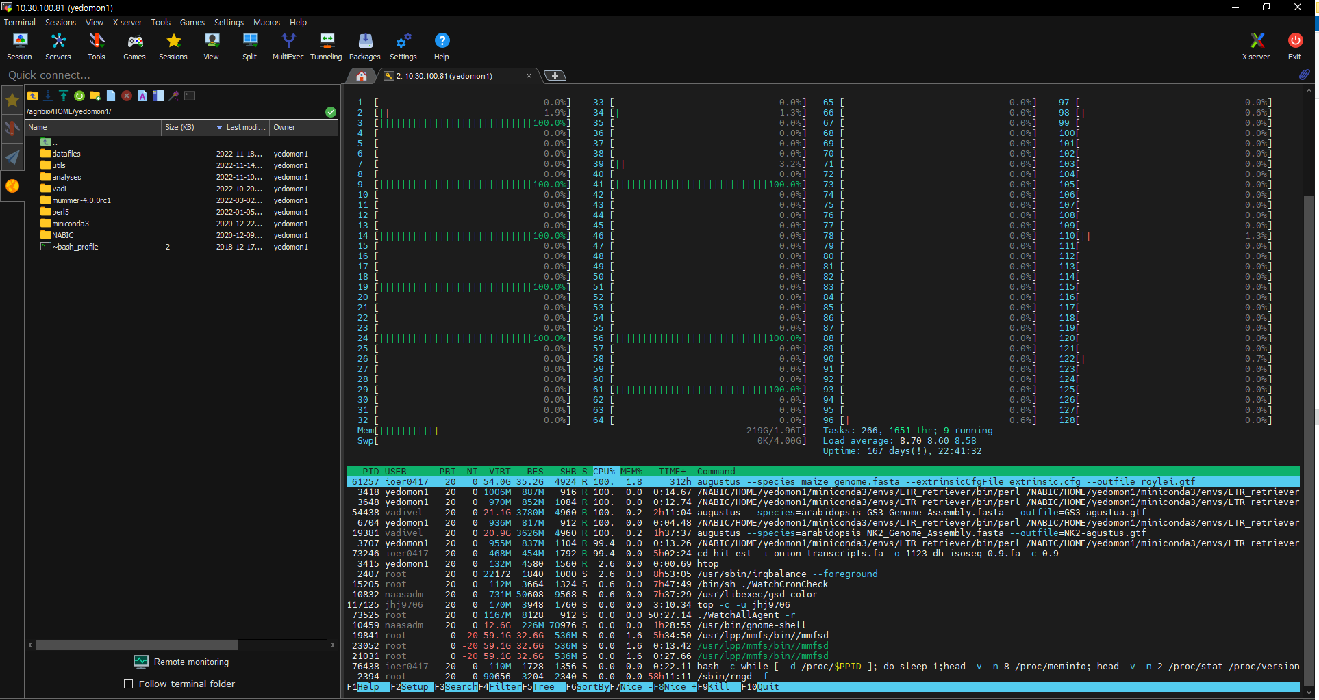
7
Monitoring
HTOP

Slide 20
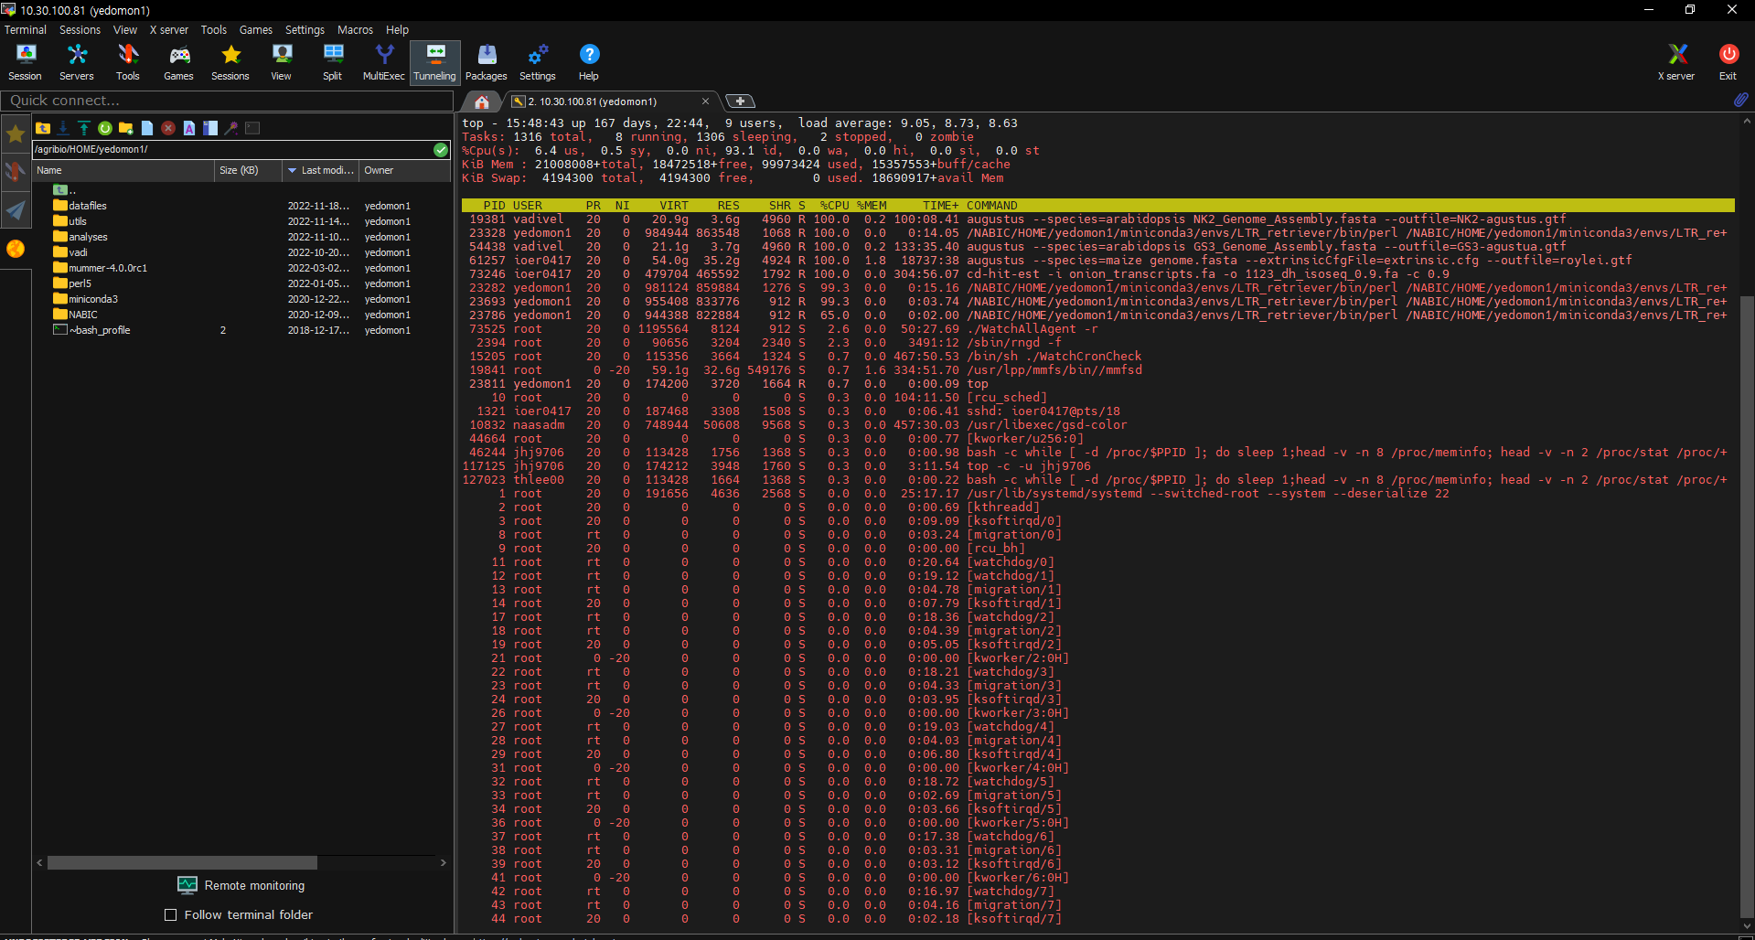
7
Monitoring
TOP

Slide 21
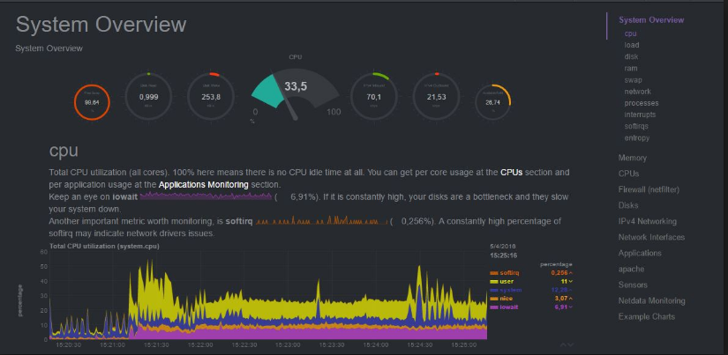
7
Monitoring
NETDATA

Slide 22
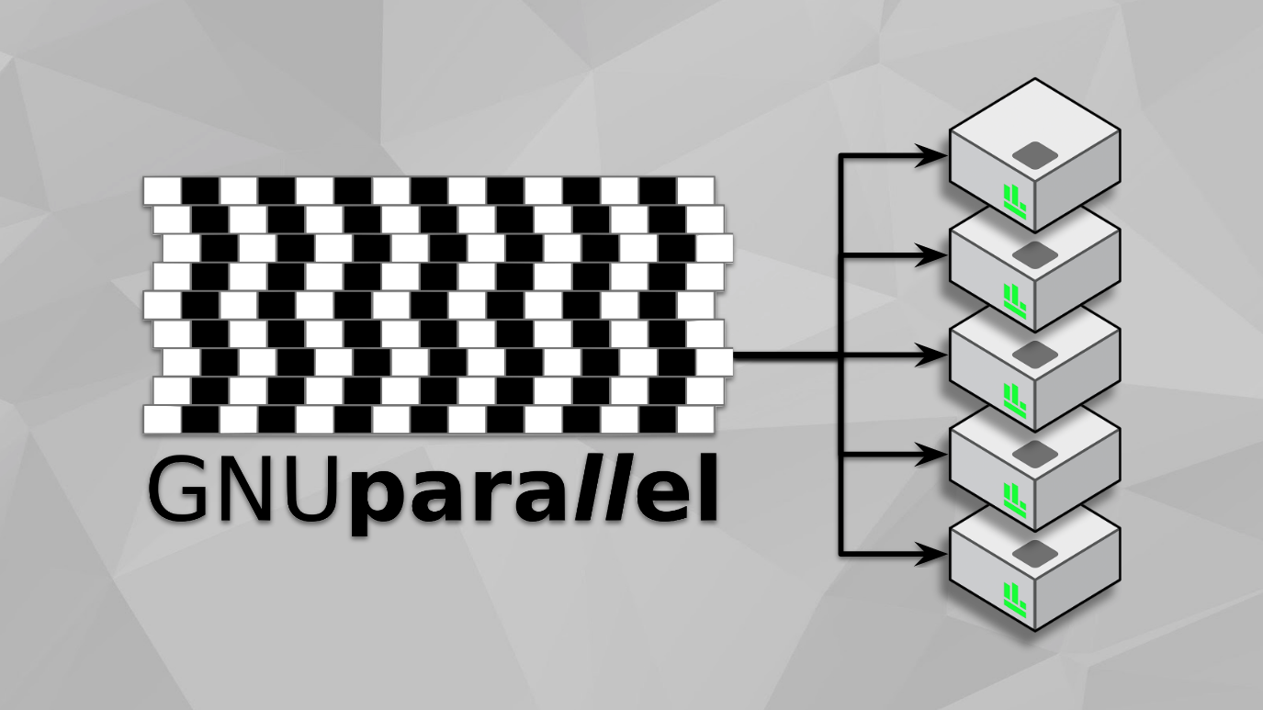
7
Monitoring
You say optimization? Get more thing dome with GNU parallel

Slide 23
8
File handling

Slide 24
8
File handling
Frequently used programs to parse files in Linux – Get familiar with them
grep
Sed
Find & Replace
sed ’s/HTU4257.1/chr1/g’ file
Pattern Matching
grep "mRNA＂ file
Awk
Data processing
awk '$1 == 100 {print $2, $3}' file

Slide 25
9
Note taking

Slide 26
9
Note taking
Evernote
Github
Jupyter Notebook
Visual Studio Code
atom

Slide 27
10
Be patient

Slide 28

10
Be patient
No 빨리빨리…
Be Patient

Slide 29
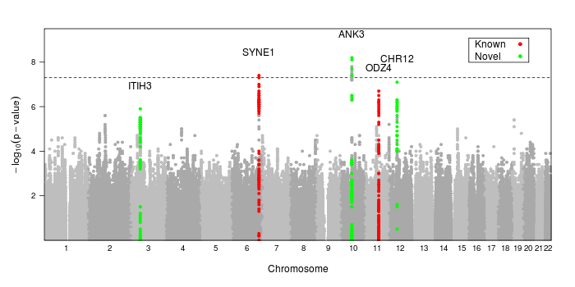
Bonus | Make a reference genome
Genome assembly
Genome annotation
QTL MAPPING
RNA
DNA
GWAS
POPULATION GENOMICS

Slide 30
Bonus | Application
DNA
SNP Calling
[GATK,bcftools]
E.g.: https://github.com/josieparis/gatk-snp-calling/
SNP Calling
[GATK,bcftools]
Gene Info
[SnpEff]
NGS Sequence data
Duplicate
[Picard]
QC & Trimming
[Trimmomatic]
Mapping
[BWA, Samtools]

Slide 31
Acknowledgments
Brandies PA, Hogg CJ (2021) Ten simple rules for getting started with command-line bioinformatics. PLoS Comput Biol 17(2): e1008645. https://doi.org/10.1371/journal.pcbi.1008645
감사함니다☺

